Slide 1

Final Project SciDB for Clustering Analysis of MovieLens Ratings Data
Liu, Wusuo
Lee, Chia Ying
CSCI E-63 Big Data Analytics
Harvard University Extension School
Prof. Zoran B. Djordjević
@Your Name
1
Liu, Wusuo and Lee, Chia Ying
Notes:
1

Slide 2
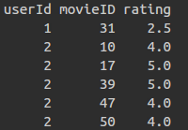
Introduction: MovieLens Data
MovieLens.org maintains a database of movie ratings
Full dataset:
27,000 rated movies
138,000 users
20 million ratings
Small dataset:
9,000 rated movies
700 users
100,000 ratings
Big Data ML Goal:
Cluster users according to similar movies they liked!
Challenge: linear algebra on huge matrices
@Your Name
2
Liu, Wusuo and Lee, Chia Ying

Slide 3
SciDB for Massive Scale Math and Stats
SciDB is designed for fast linear algebra on large arrays. Efficient architecture for data storage and distributed computing suitable for mathematical and statistical operations
Demo of SciDB's capabilities:
Sparse matrix multiply
Singular Value Decomposition
Demo 2 clustering methods using SciDB:
Cluster users based on correlations between users' ratings.
Cluster users by Principle Component Analysis.
Use small dataset due to limited resources.
@Your Name
3
Liu, Wusuo and Lee, Chia Ying

Slide 4
Installation Notes
Follow the instructions on: https://paradigm4.atlassian.net/wiki/display/ESD/SciDB+Community+Edition+Installation+Guide
The VM that has scidb installed provided by paradigm4 https://drive.google.com/drive/folders/0B7yt0n33Us0rT1FJdmxFV2g0OHc
has several problems:
The pre-installed scidb R package is severely outdated. Several functions documented in the package are not available.
There exists a problem with the system’s MPI library that would prevent us to perform many important linear algebra operations like gesvd().
Install scidb 15.12 on Ubuntu 14.04 from scratch.
@Your Name
4
Liu, Wusuo and Lee, Chia Ying

Slide 5
Installation Notes
Ubuntu 14.04 download and set-up:
http://releases.ubuntu.com/14.04/
scidb installation requires passwords for both the root and scidb users on all the hosts. So the root login must be enabled on Ubuntu. This link explains the setup: https://askubuntu.com/questions/44418/how-to-enable-root-login
SSH public key
Following section “Providing Passwordless SSH” in the installation document
Copy the generated public key file id_rsa.pub in the /home/.ssh directory to the ./ssh directories of all the users living on the cluster of one or more hosts, and rename it as “authorized_keys”
In our case, 1 host 2 uses, “scidb” and “root”, so copy and rename id_rsa.pub to /home/.ssh and /root/.ssh.
The /.ssh directories are hidden by default in Ubuntu 14.04.
@Your Name
5
Liu, Wusuo and Lee, Chia Ying

Slide 6
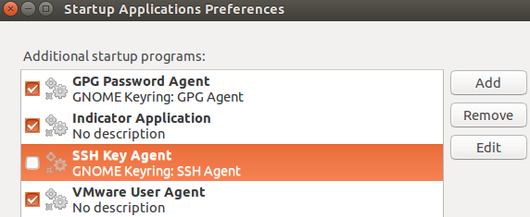
Installation Notes
“Agent admitted failure to sign using the key”
After deploying scidb access to the users, to confirm the connection, the above error could happen.
Cause: Ubuntu desktop system uses gnome-keyring, which doesn’t always handle specific formats of SSH keys correctly.
To confirm the cause, add SSH_AUTH_SOCK=0 in front of ssh connecting command, e.g.
SSH_AUTH_SOCK=0 ssh scidb@127.0.0.1
Solution: uncheck SSH key Agent in “Startup Applications Preferences”.
@Your Name
6
Liu, Wusuo and Lee, Chia Ying

Slide 7
Installation Notes
Build from source, ./run.py make
Assign as much memory as possible to the VM. Several compiling steps need considerable amount of memory. If the memory is not enough, it runs into fatal errors.
Assign appropriate number of processors to the VM in order to compile the source code in parallel fashion, e.g. ./run.py make -j4 (4 threads)
Install R, Rstudio, R package scidb
Do not install the CRAN package scidb 2.0.0, which currently is not stable.
Install the package from github by devtools::install_github("Paradigm4/SciDBR")
To install devtools, first in terminal do
sudo apt-get install libcurl4-openssl-dev libssl-dev
In R terminal, execute install.packages("devtools")
@Your Name
7
Liu, Wusuo and Lee, Chia Ying
Notes:
according to their vignette, the

Slide 8
Installation Notes
Install shim
shim is a simple SciDB client that exposes limited SciDB functionality through a simple HTTP API.
Will enable us to connect to localhost:8080 (if the host IP is set as 127.0.0.1) and submit iquery.
Will enable us to connect scidb in R.
Instruction site: https://github.com/Paradigm4/shim
Head to section “LD_LIBRARY_PATH issues” if a library linking error happens when trying to run shim
@Your Name
8
Liu, Wusuo and Lee, Chia Ying
Notes:
according to their vignette, the

Slide 9
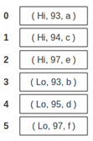

SciDB Arrays
SciDB arrays are the basic data structure
Arrays have one or more dimensions, and one or more attributes
Dimensions index the array cell
Attributes store the data
Dimensions play a similar role to primary keys in other databases
1D array (3 attributes)
2D array (1 attribute)
Redimension
Poliakov, Brown. Using SciDB and SciDB-R. Paradigm4 2013
@Your Name
9
Liu, Wusuo and Lee, Chia Ying

Slide 10
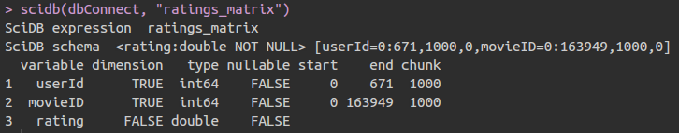
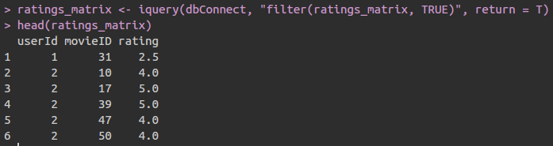
SciDB Schema
The SciDB schema defines the array structure and data types
Arrays are stored efficiently in sparse format
Arrays are stored in chunks may overlap to facilitate math ops.
@Your Name
10
Liu, Wusuo and Lee, Chia Ying

Slide 11


SciDB Query Language and R package
AQL is the basic SciDB query language
AFL is the query language for functions in SciDB
The scidb package provides an interface to R
@Your Name
11
Liu, Wusuo and Lee, Chia Ying

Slide 12
Loading Data from CSV File into SciDB
Step 1a: Create a 1D array ratings AFL% CREATE ARRAY ratings <userId:int64, movieID:int64, rating:double NOT NULL, timestamp:int64> [i=0:?,1000000,0];
Step 1b: Load from CSV into array AFL% load(ratings, 'ratings_noHeader.csv', -2, 'csv');
Step 2: Redimension from 1D to 2D array ratings_matrix AFL% store(redimension(ratings, <rating:double NOT NULL>[userId=0:671,?,0,movieID=0:163949,?,0]), ratings_matrix);
@Your Name
12
Liu, Wusuo and Lee, Chia Ying

Slide 13
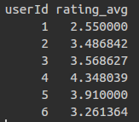
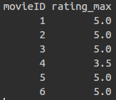
Computing Statistics in SciDB
What is the average rating of each user? AFL% aggregate(ratings_matrix, avg(rating), userId) What is the maximum rating a movie has received? AFL% aggregate(ratings_matrix, max(rating), movieID)
@Your Name
13
Liu, Wusuo and Lee, Chia Ying

Slide 14
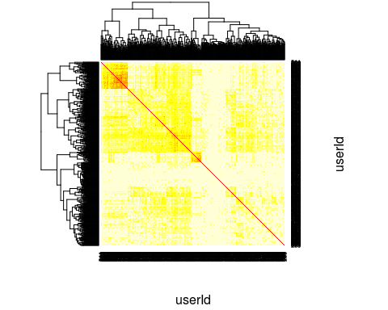
Clustering Analysis #1: Based on Correlation
Correlation matrix: M * M^{T} AFL% load_library('linear_algebra') AFL% spgemm(ratings_matrix, transpose(ratings_matrix))
@Your Name
14
Liu, Wusuo and Lee, Chia Ying

Slide 15
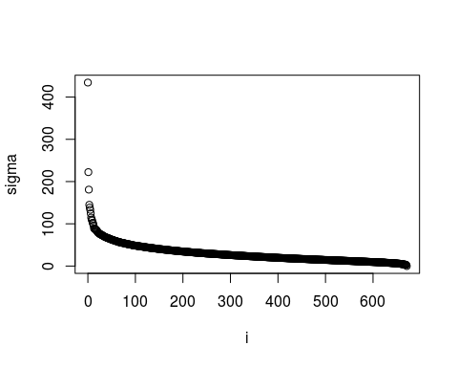
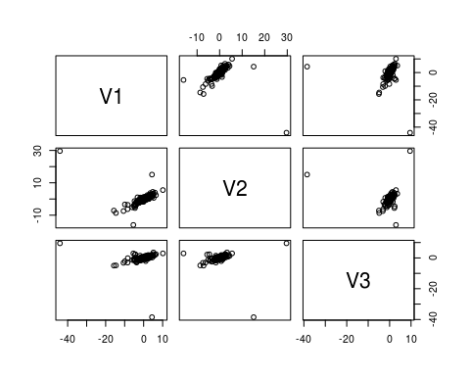
Clustering Analysis #2: based on PCA and SVD
Singular Value Decomposition: M = U * S * V^{T} AFL% load_library('dense_linear_algebra') AFL% gesvd(ratings_matrix_centered, 'S') AFL% gesvd(ratings_matrix_centered, 'U')
@Your Name
15
Liu, Wusuo and Lee, Chia Ying

Slide 16
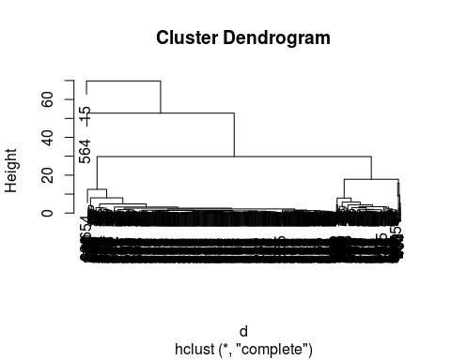
Clustering Analysis #2: based on PCA and SVD
Hierarchical clustering using top 3 singular vectors.
@Your Name
16
Liu, Wusuo and Lee, Chia Ying

Slide 17
Conclusion
SciDB is an efficient database designed for mathematical and statistical operations on large data
SciDB has functionality to perform sparse matrix multiplication and SVD on massive matrices.
SciDB can be used in conjunction with R language to perform Machine Learning tasks.
We have shown the potential of using SciDB in clustering users based on their movie ratings.
SciDB Enterprise Edition has enhanced functionality
E.g. Truncated SVD, glm, etc.
@Your Name
17
Liu, Wusuo and Lee, Chia Ying

Slide 18
YouTube URLs, Last Page
Two minute (short): https://youtu.be/1o5jLqXAXZs
15 minutes (long): https://youtu.be/qlwy4fOXLvk
Liu, Wusuo and Lee, Chia Ying
18

